Slide 1
Chicago Schools Performance Analysis
Jacob Davis
STAT 281

Slide 2
Introduction
A student’s adequate performance determines their probability of graduating, and perhaps seeking further education
School districts take an interest in the performance of their students, and apply different programs and policies to improve performance

Slide 3
Goal of Analysis
Understand what factors, both in and out of the classroom, affect a students likelihood of graduating high school
Identify what a school district can do to promote higher performance

Slide 4
The Data
Data comes from Chicago Public Schools Report Card for 2011-2012 school year
  Response Variable: Graduation Rate
  Explanatory Variables are scores the school has received in different areas (i.e. Safety Score, Teacher Score, Family Involvement Score, etc)

Slide 5
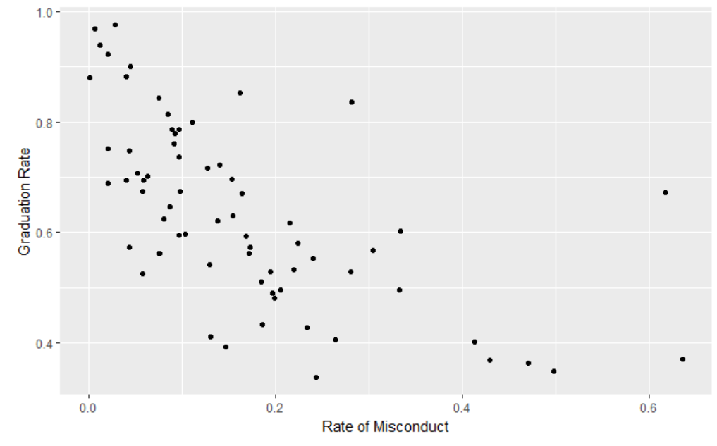
Data Exploration
Several of the variables showed obvious correlations to Graduation Rate.

Slide 6
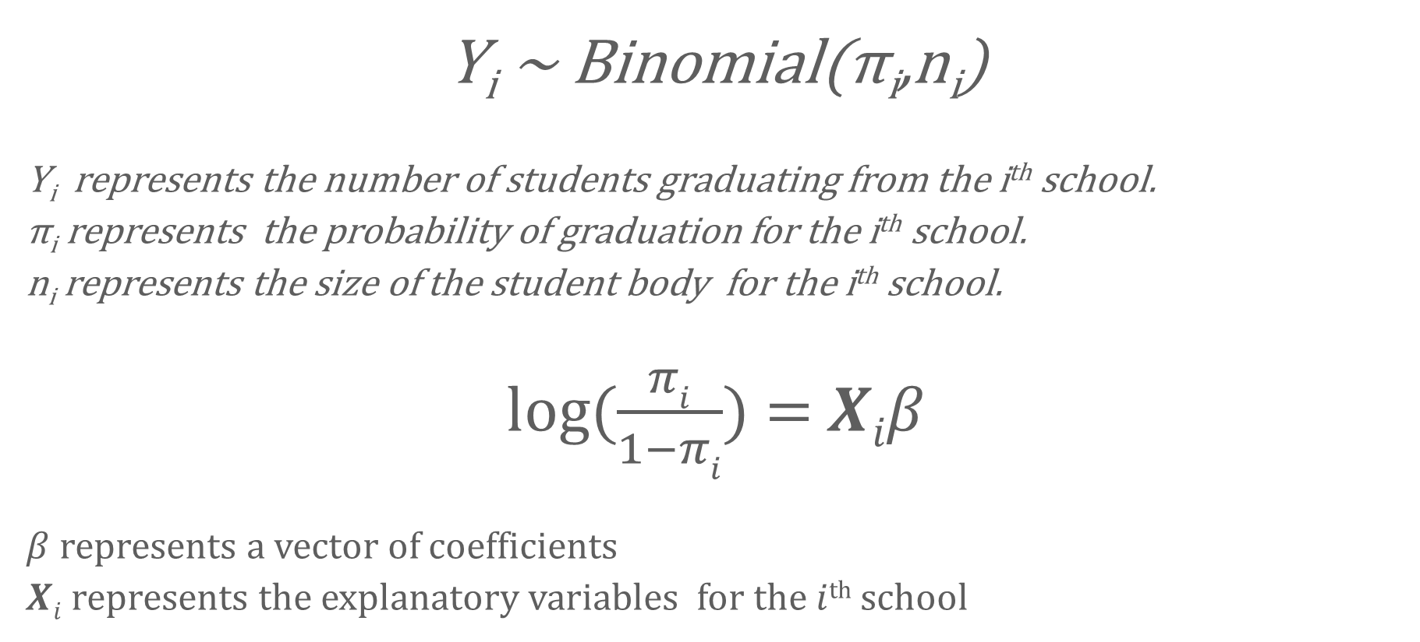
Model
Y_{i} ~ Binomial(π_{i},n_{i})
Y_{i} represents the number of students graduating from the i^{th} school.
π_{i} represents the probability of graduation for the i^{th} school.
n_{i} represents the size of the student body for the i^{th} school.
log($\frac{πi}{1−πi}$) = $Xiβ$
$β$ represents a vector of coefficients
$Xi$ represents the explanatory variables for the $i$^{th} school

Slide 7
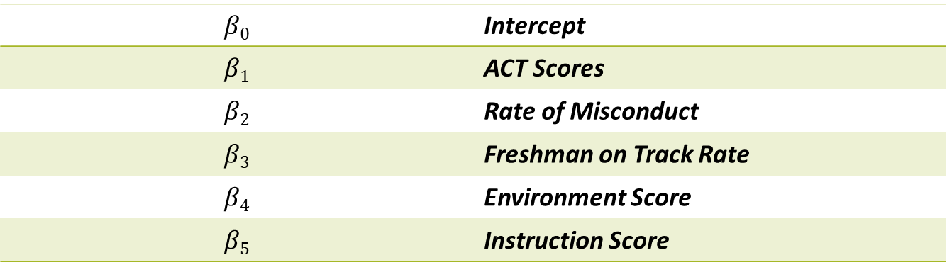

Model
$β$ = [$β\text{0},β$₁, $β$₂, $β$₃, $β4,$ $β5$]
$$β\text{0}$$ | Intercept
$$β\text{1}$$ | ACT Scores
$$β\text{2}$$ | Rate of Misconduct
$$β\text{3}$$ | Freshman on Track Rate
$$β\text{4}$$ | Environment Score
$$β\text{5}$$ | Instruction Score

Slide 8
Assumptions
Each school is considered relatively independent from one another
No significant collinearity between variables
Probability is monotone in each variable
Variance Inflation Factors
ACT | Freshman on Track Rate | Instruction Score | Rate of Misconduct | Environment Score
3.738 | 1.686 | 2.762 | 1.492 | 4.913

Slide 9
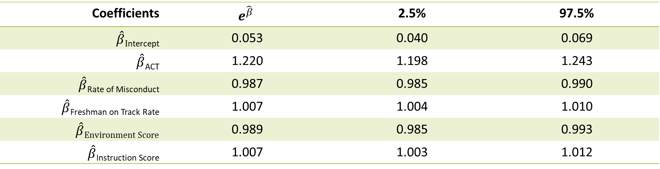
Model Estimates
Coefficients | $$e^{\hat{β}}$$ | 2.5% | 97.5%
$\hat{β}I$_{ntercept} | 0.053 | 0.040 | 0.069
$\hat{β}$_{ACT} | 1.220 | 1.198 | 1.243
$\hat{β}$_{Rate of Misconduct} | 0.987 | 0.985 | 0.990
$\hat{β}$_{Freshman on Track Rate} | 1.007 | 1.004 | 1.010
$$\hat{β}Environment Score$$ | 0.989 | 0.985 | 0.993
$\hat{β}$_{Instruction Score} | 1.007 | 1.003 | 1.012

Slide 10
Strengths/Weaknesses
Strengths
  Simple model, only five explanatory variables
  Most predictions are within 11% of the true value
Weaknesses
  Difficult to get accurate predictions for larger schools since there are fewer large schools in our model

Slide 11
Conclusion
School Recommendations
  Focus on getting students to take the ACT
Future Analyses
  Study ONE school specifically and collect data of the students to predict who is most at-risk of not graduating

